Slide 1
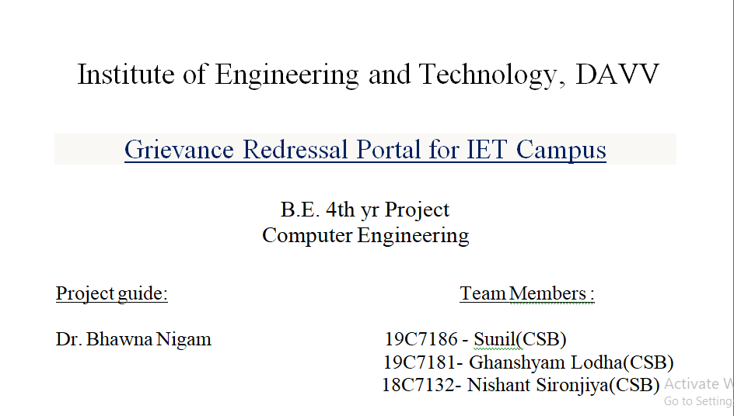

Slide 2
INDEX
Problem Domain
Literature Survey
Solution Domain
Use Case Diagram
Overview
Learning from the project

Slide 3
Problem Domain:-
Complaint Management System :-
Our college education system is very well but we analyze some problem regarding to complaint management. In our college, complaint management system is slow due to which the problem seems to be more time consuming student required paper work also due to this student were afraid they feel that his name would come. We analyze this entire problem and we designed a portal which is GRIEVANCE REDRESSAL PORTAL.

Slide 4
Cont.....
In this portal students and faculty members can complaint easily, and their complaint will be redressed by the cell member (Principal Sir, HOD sir). Cell members will give feedback to students and faculty member’s problem. It is very easy and fast way for complaint management.

Slide 5
Literature Survey:-
There was no portal in most of college for complain management.
Other process required lot of time.
For solution of student’s & teacher’s problem.
An easy and attractive way.

Slide 6
Cont.....
Available Complaint Portals:
University Grant Commission(Grievance Redressal Portal):
UGC grievance portal have facilities online registration of students' grievances, send reminders and check action-taken status in connection with their concerns. A student can register complaints regarding admission process, reservation policy, discrimination on the basis of caste and even non-declaration of results through the portal — www.ugc.ac.in.

Slide 7
Cont.....
All India Council of Technical Education(AICTE):
Redressal of all types of Grievances, Complaints and Malpractices received from Individuals, Institutions, Government and Statutory & Professional bodies - https://www.aicte-india.org/bureaus/grievance-redressal.

Slide 8
Solution Domain:-
The system registers the complaints of the student through an integrated interface. Whenever a student has got any complaint related to the Campus, regarding Library, Labs or college Infrastructure then they can make online complaints. Their complaints are being taken care by the respective authorities. The student can track the progress of their complaint being solved through a given Complaint ID.

Slide 9
Cont.....
When user create their account he/ she have to select their role like student ,faculty or other. It may be possible that some of the college member doesn’t have college ID for that. we have added other option. After creating and verify their account they can login successfully and can submit their complaint if any. In admin section admin can see all the complaints of user with user details like photo, role, enrollment etc. and can change the status of the user complaint and after completion admin can delete complaint that will store in history for future reference.

Slide 10
Use-case Diagram :-
Student Activity
Do-Complaint
Register
Complaint Status
Student
Login
Logout
Faculty Activity
Do-Complaint
Register
Complaint status
Faculty
Login
Logout

Slide 11
Cont.....
Other Member Activity
Do-Complaint
Register
Complaint Status
Other
Login
Logout

Slide 12
Cont…
Admin Activity
Check Complain
Login
Update Status
Do Feedback
Admin
History
Delete

Slide 13
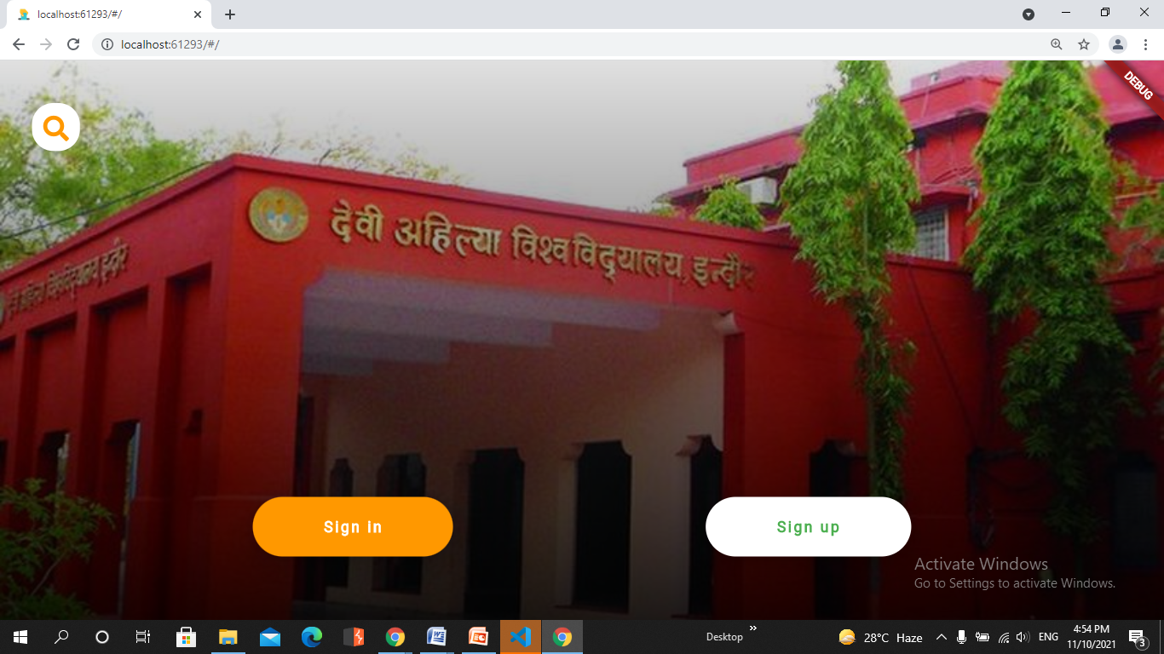
Project overview :-

Slide 14
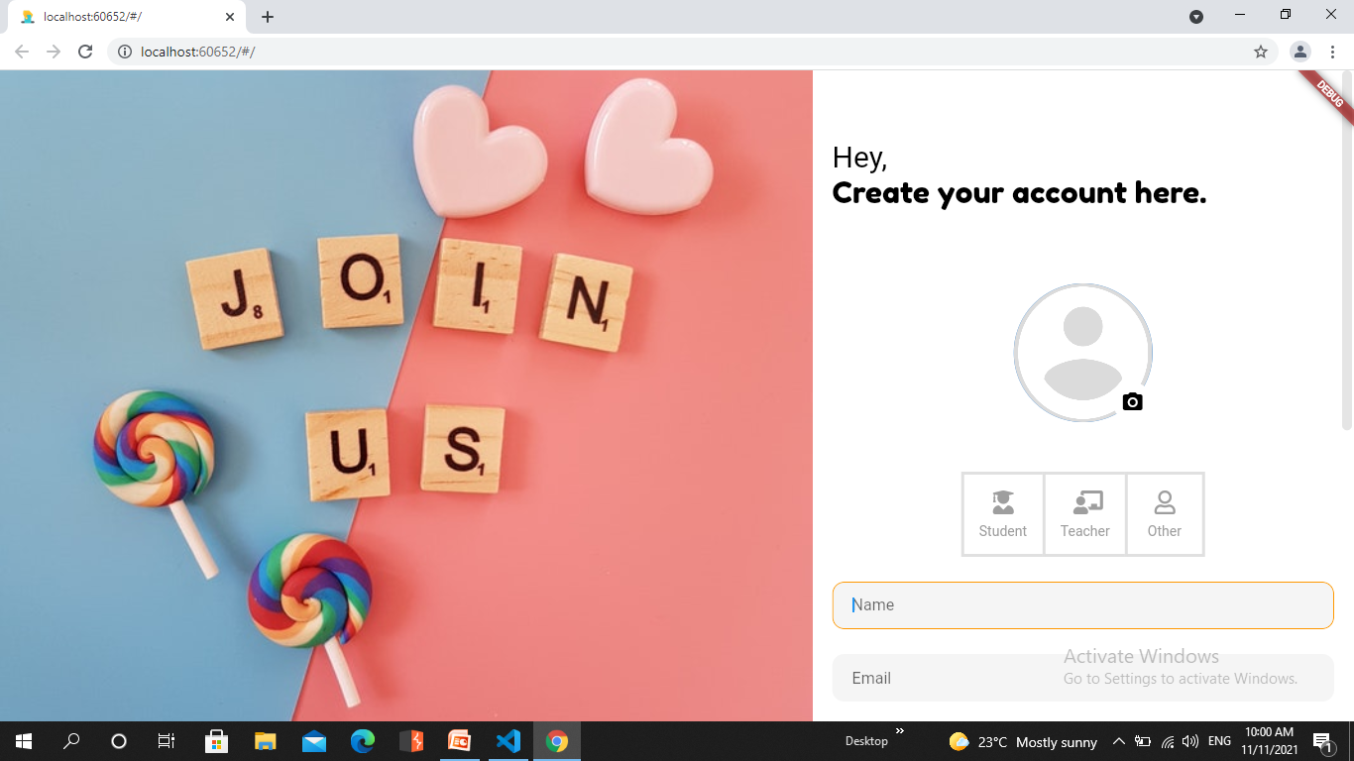

Slide 15
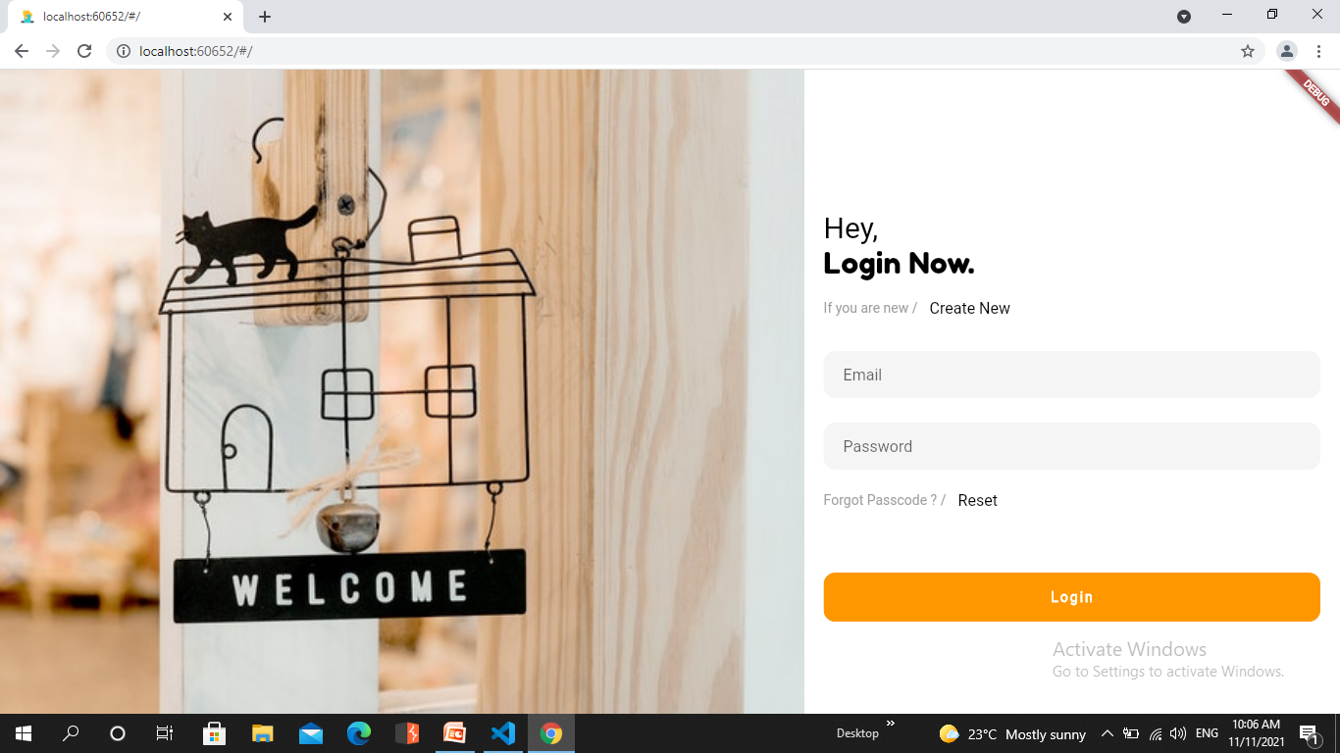

Slide 16
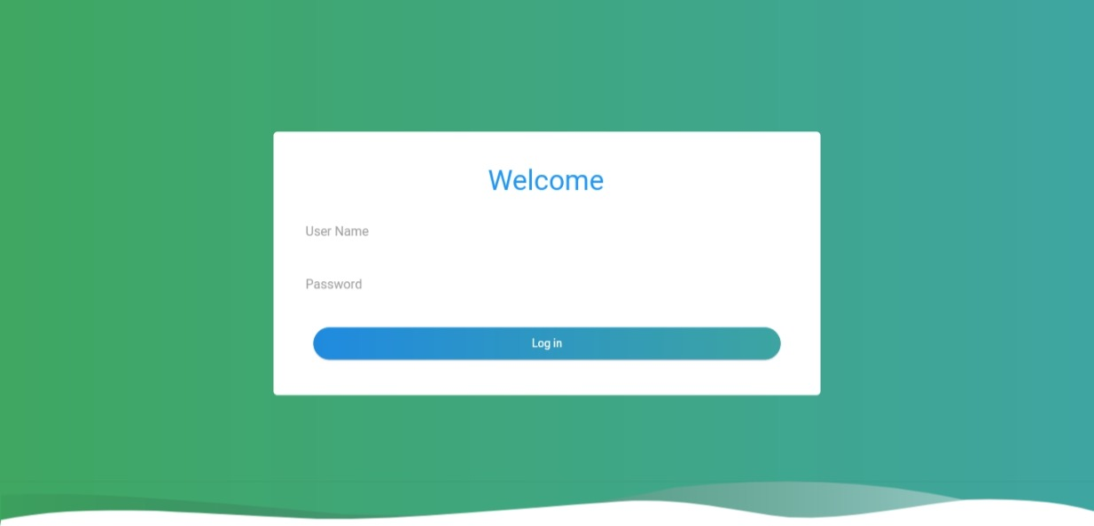
Admin Panel:-

Slide 17
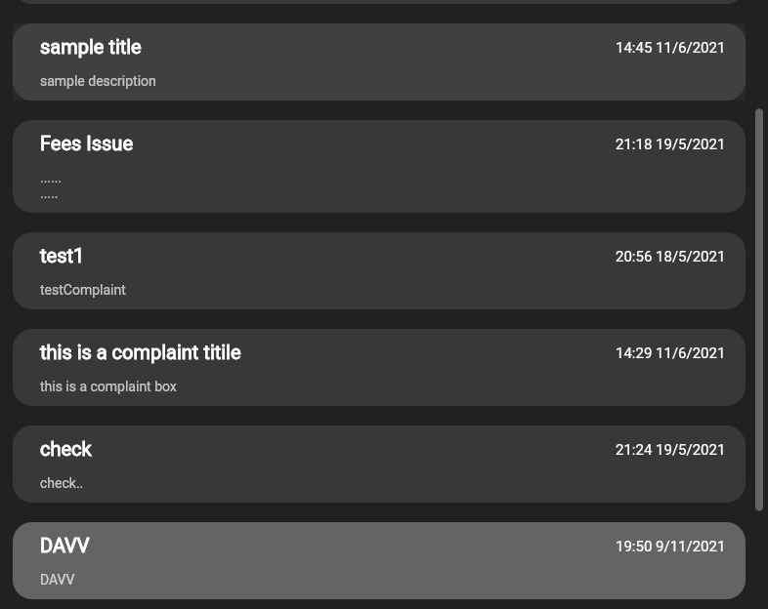

Slide 18
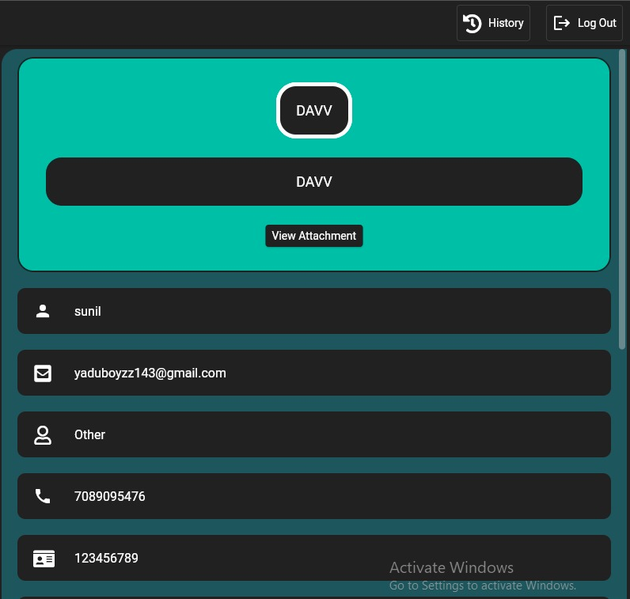

Slide 19
Learning from the project:-
Easy to solve problem
With the help of this project anyone can raise their issue securely and can check the status of their issue anytime.
With the help of different technology we can make things easier.

Slide 20
Cont…..
IDE :- Android Studio & VS Code
Frame Work :- Flutter
Data Base :- Firebase
Language :- Dart

Slide 21
Thank you …

